Slide 1
Exercise 10b Stalling and Spin Avoidance
Phase 3
Aim - as syllabus
Copyright Marcus Furniss 2019

Slide 2
The Stall
https://www.youtube.com/watch?v=WFcW5-1NP60
Watch for 40 seconds

Slide 3
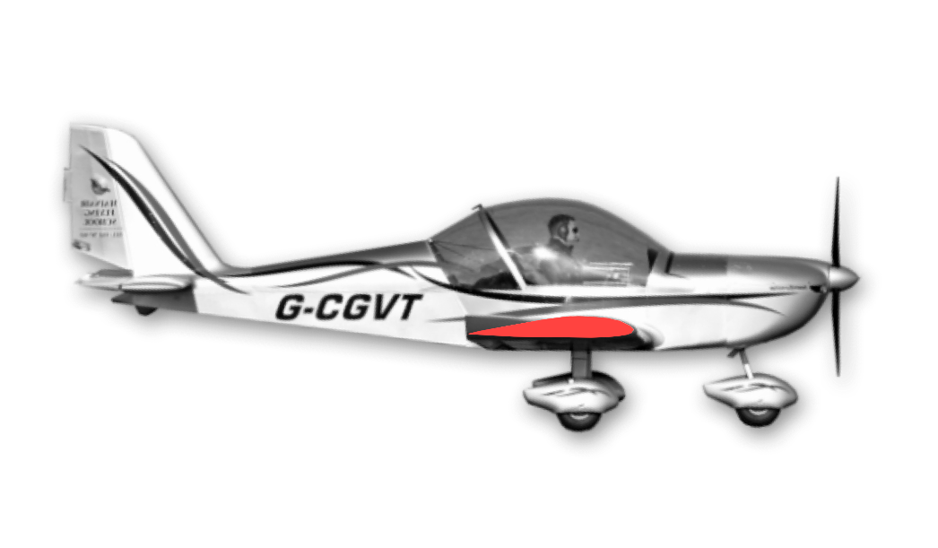
Stalling
In this exercise we will look at
The characteristics of the fully developed stall
How best to recover from it with minimum height loss
How to safely enter a stall so we can practice it and hopefully avoid it inadvertently

Slide 4
Theory – The Stall
The stall occurs whenever the Critical Angle of Attack is exceeded
Fully controlled flight is not possible below this critical angle and airspeed
44mph @ MTOW Ev-97, 41KTS C42

Slide 5
Theory - Relative Airflow
Angle of Attack (AOA) is the angle between the chord line of the wing and the relative airflow
Angle of Attack
Relative Airflow

Slide 6
Theory - Relative Airflow
Angle of Attack (AOA) is the angle between the chord line of the wing and the relative airflow
The Critical Angle is the AOA at which the airflow over the top surface of wing stalls
Critical Angle
Relative Airflow

Slide 7
Relative Airflow
It is possible for the aircraft to be stalled in any attitude
Critical Angle
Critical Angle
Critical Angle
Relative Airflow
Relative Airflow
Relative Airflow

Slide 8
The Stall
This can happen when handling mistakes are made:
Flying too slowly
Inadvertently flying too slowly (the biggest cause!)
Not appreciating stall speed will vary with load factor and weight carried (ie turning at too low an airspeed)
High speed stall
Caused by pitching up abruptly at speed
Following engine failure in the climb
If pilot is slow to correct nose high attitude/low airspeed

Slide 9
The Stall
This can also happen due to mishandling environmental factors:
In wind shear or wind gradient;
Most noticable the last few hundred feet above ground (…especially on 26 at Barton!)
Can cause a sudden loss of speed to an aircraft approaching to land
But can be anticipated and avoided using correct landing approach techniques

Slide 10
Indications of Slow Flight
Air Speed Indicator (ASI)
The ASI has a lag and can also be subject to errors when flying through rain
Reduced Airflow
This is a good indication in open cockpit aircraft with pusher prop (ie Flexwing)
Noise reduction due reduced airflow
Possible nose high attitude
Become familiar with correct pitch attitude for different power and flap setting
Pitch control position and pressure
Control column will be aft of normal position and there will be forwards pressure as aircraft tries to return to trimmed cruise speed

Slide 11
Indications of Slow Flight
Altered control response
Pitch control will feel ‘nose heavy’
Ailerons and rudder will be lighter and less effective (Mushy!)
Note - elevator and rudder will be more responsive at high power settings due increased propeller slipstream
Balance
High power in slow flight tends to yaw EV-97 and C42 to left due finer pitch of slipstream so more right rudder is required to maintain balance
Yaw could lead to possible lateral instability

Slide 12
The Incipient Stall - Indications
Aerodynamic buffet
Shaking felt through the stick and airframe caused by airflow starting to separate
Nose heaviness
As the airflow separates the centre of pressure moves rearwards
Lateral instability
More airflow separation on one wing than other

Slide 13
The Stall - Indications
Further increase in AOA leads to a fully developed stall
Decrease in lift
Increase in drag
You will feel aerodynamic buffet followed by
Nose drop
Possible wing drop
Height loss

Slide 14
Recovery from a Fully Developed Stall
HOW?
Reduce angle of attack by moving stick forwards

Slide 15
Pitch Only Recovery (POR)
When additional power is not available
ie full power climb, glide after engine failure
Move control column forwards to reduce AOA
Positive but not too excessive (release back pressure)

Slide 16
Pitch Only Recovery (POR)
When additional power is not available
ie full power climb, glide after engine failure
Move control column forwards to reduce AOA
Positive but not too excessive (release back pressure)
As soon as airspeed safe, raise nose appropriate attitude to minimise height loss

Slide 17
Standard Stall Recovery (SSR)
Coordinated input allows a recovery with minimum height loss
Simultaneously
Move control column forwards to reduce AOA
Increase power (usually full power) – to aid acceleration with minimum height loss
As soon as airspeed safe, raise nose and adopt a full powered shallow climb

Slide 18
Standard Stall Recovery (SSR)
This is a skill that requires practice;
Don’t raise nose too quickly otherwise a secondary stall may occur
Don’t raise nose too slowly otherwise excessive height loss will occur
If nose drops well below horizon delay power to prevent excessive height loss

Slide 19
Wing Drop at the Stall
Un-stall the aircraft in the normal way (SSR)
During recovery
Hold the ailerons neutral
Apply (top) rudder to prevent further yaw towards the dropping wing
Avoid excessive rudder input as this may cause a flick into an opposite wing drop
When aircraft has un-stalled use coordinated ailerons and rudder in the normal way to level wings and balance
Adopt a full powered shallow climb

Slide 20
Stalling in a Turn
Occurs at higher speed that straight flight
Angle of bank may increase/reduce/stay same
Apply the Standard Stall Recovery
When aircraft has un-stalled use coordinated ailerons and rudder in the normal way to level wings and balance
Adopt a full powered shallow climb

Slide 21
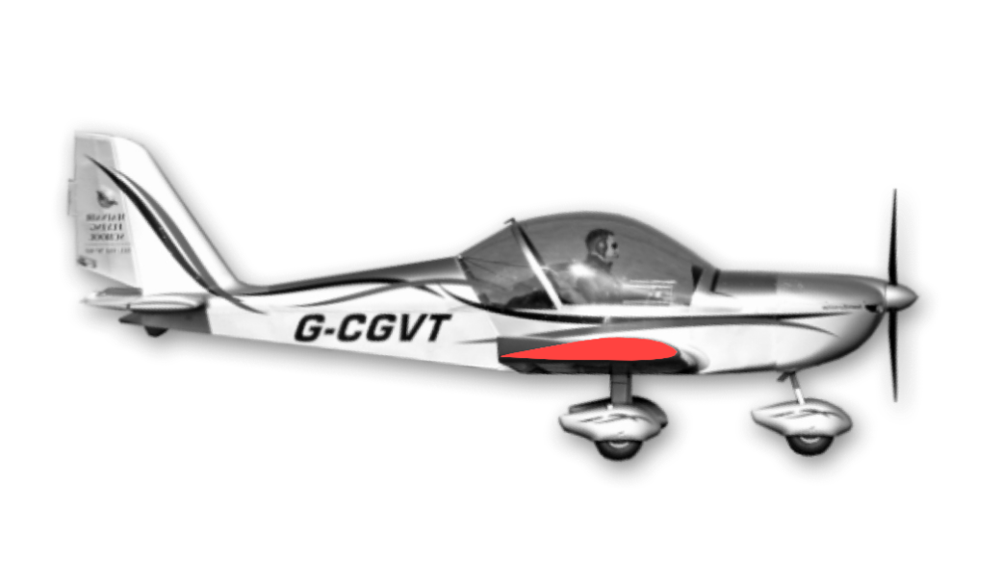
The Effect of Flaps on Stalling
With flaps extended
The wing will now produce the same lift at a lower airspeed
The stalling speed will be lower than without flaps
The onset of stall will be greater due to increased drag
Possibly more aggressive nose or wing drop
The nose attitude will be lower at the stall than without flaps
44mph EV-97
36mph

Slide 22
Recovery from the Stall with Flaps
Apply the Standard Stall Recovery
When raising the nose be aware of the lower nose attitude necessary to maintain a safe airspeed with flaps extended
Once a positive rate of climb is established retract flaps in stages

Slide 23
To Enter a Wings Level Practice Stall
Select power and flaps setting to be used;
Raise the nose in relation to the horizon and hold
As airspeed reduces move stick progressively back until the stall occurs
or
Reduce power to idle and use elevator to maintain altitude until aircraft stalls
During entries to turning stalls hold off overbank as airspeed is reduced

Slide 24
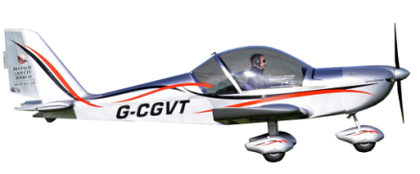
Stall Recovery Summary
SSR
Pitch only recovery
No pilot input
50’
150’
500’
A well executed standard stall recovery can be made with as little as 50 feet height loss

Slide 25
Spin Avoidance
A spin is a condition of stalled flight in which the aircraft describes a spiral descent
Balanced flight can be difficult to maintain close to stall
If yaw is allowed to occur close to the stall a spin may develop
The inner wing decelerates, drops increasing AOA…and stalls
The aircraft will then yaw and roll towards the stalled wing, the nose drops and a spin is entered

Slide 26
Spin Avoidance
In a spin an aircraft is;
Stalled
Rolling
Yawing
Pitching
Side-slipping
LOSING HEIGHT RAPIDLY!
The rotation in a spin can be very disorientating – watch this!
https://www.youtube.com/watch?v=eVGtsK7vvnA
Apologies for the swearing ☺

Slide 27
Spin Avoidance/Prevention
Avoid temptation to pick up a dropped wing with ailerons close to the stall
It may have the reverse effect!
Maintain balance accurately with rudder when flying slow
Never practice slow flight near the ground
Control airspeed accurately when turning and with flaps
Base to final turn…the ‘Deadly’ turn!

Slide 28
Spin Avoidance/Prevention
Recovery
Close throttle
Ailerons neutral (or let go of the stick!)
Full opposite rudder to direction of spin (look directly over nose to determine direction of spin)
PAUSE
Stick forward until spin stops (if it hasn’t already)
Centralise rudder
Pull out of dive
‘Look straight down over the nose and push on the rudder to catch up with the world. If the world is racing away to the left, push the left rudder’ Curtis Pitts

Slide 29
Airmanship
H
Height – minimum 1000 AGL
Airframe - flaps set as applicable, limit speed noted
Security – straps loose articles
Engine – Temperatures and Pressure OK, fuel level
Location – Clear of Airspace, Built up areas, Cloud
Lookout – clearing turn to see all around, above, below
A
S
E
L
L

Slide 30
Exercise 10b Stalling and Spin Avoidance
Questions?

