Slide 1
Exercise 14 Advanced Turning
Phase 5
Aim - as syllabus
Copyright Marcus Furniss 2019

Slide 2
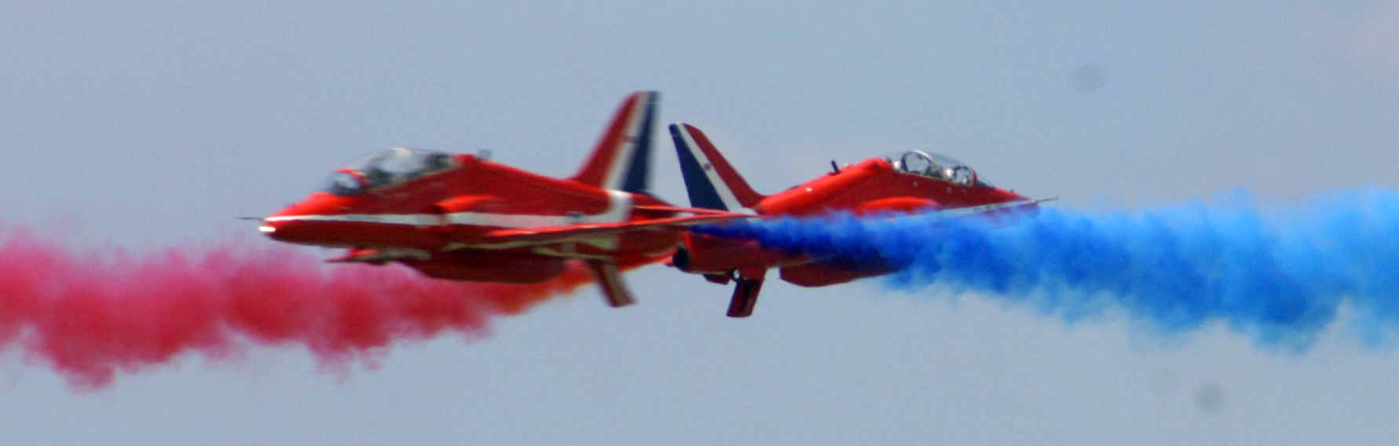
Why?
Collision Avoidance!
A steep turn produces a high rate and small radius of turn…

Slide 3
Exercise 14 – Advanced Turning
Advanced turns for C42 are over 30 up to 60 degrees of bank. Why 60deg?
L
V
L
Additional lift required to maintain level flight
L = W
W
W
To turn an A/C we need to bank the A/C
Vertical component of lift (V) is reduced – V does not equal W
A/C will descend and speed will increase

Slide 4
Exercise 14 – Advanced Turning
L
V
L
L = W
V = W
2 x Turn Force
W
Load Factor
W
HOW?
Twice lift required in level 60deg banked turn
⬆ AOA (stick back) = ⬆ Lift + ⬆ Induced Drag
More power to maintain A/S
@ 60 deg, Load Factor doubles to 2g, stall speed increases by 41%...?
For C42, 41% increase in 41Kts = 58Kts
Significant wake turbulence is produced
Steep turn produces a high rate and small radius of turn

Slide 5
Exercise 14 – Advanced Turning
Steep climbing turns
In a climbing turn, climb rate is significantly reduced at high bank angles (lift force is tilted to produce turning force)
Steep descending turns
In a descending turn descent rate increases significantly at high bank angles
Allow for when manoeuvring, especially at low level
Do not confuse with spiral dive – this manoeuvre is flow with steady A/S and under control
Manage Airspeed!
Too much back pressure on stick…
can result in low A/S with high bank angle…Stall
Too little back pressure on stick…
can result in nose low and A/S increasing…Spiral dive

Slide 6
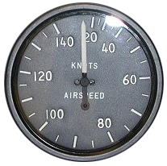
Exercise 14 – Advanced Turning
H.A.S.E.L.L. Check
Entry
Reference point for turn exit/heading
Target A/S + level flight (80Kts)
Look out – lift wing to clear blind spot then look opposite direction round into turn
75 - 85 KTS
opp
turn
4. Roll into turn, coordinating aileron + rudder. Centralise aileron and rudder at desired bank angle to stop rolling movement and balance turn
As we roll in simultaneously;
Stick back (⬆ AOA) to maintain height and stop nose from dropping into the turn (ref horizon, checked with VSI and Altimeter)
Increase power to maintain A/S (ASI)

Slide 7
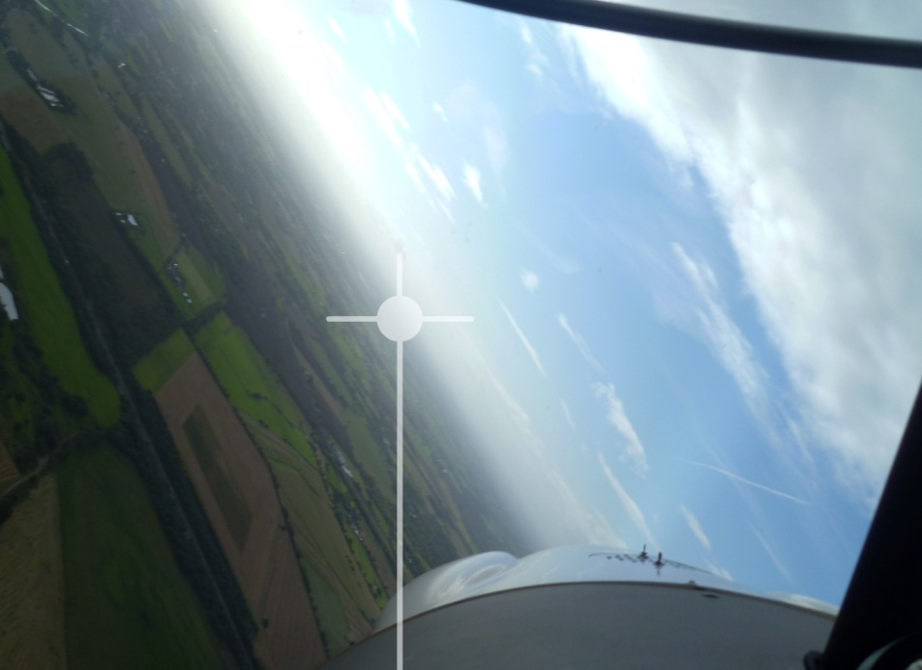
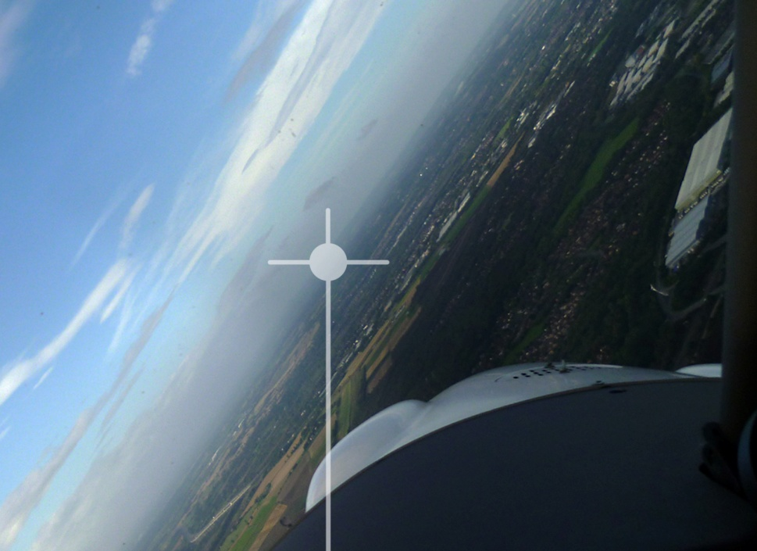
Exercise 14 – Advanced Turning
Side by side a/c have a different horizon perspective for left and right turns
The horizon is the primary reference for both bank and pitch
DO NOT CHASE THE INSTRUMENTS

Slide 8
Exercise 14 – Advanced Turning
Maintain level turn
Monitor | Input | Reference
Bank | Roll (Stick) | Horizon
Balance | Yaw (Rudder) | Balance Ball
Height | Pitch (Stick) | Horizon, VSI, ASI
Airspeed | Power (Throttle) | ASI
Exit
Anticipate reference point (30 deg)
Roll out of turn, coordinating aileron + rudder and simultaneously;
Progressively reduce power as required and…
Relax back pressure on column to attain the level flight attitude
Centralise roll and yaw inputs when wings level

Slide 9
Exercise 14 – Collision Avoidance Turn
Aim – simulate avoidance of an aircraft spotted at close range on a head on collision course
Maximum bank angle turn through 90 deg usually to RIGHT
Manoeuvre should be RAPID and SAFE, not necessarily ‘super accurate’

Slide 10
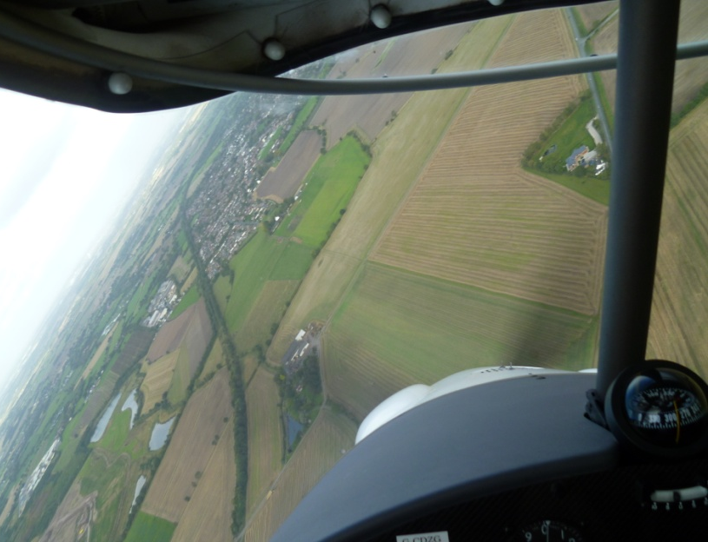
Exercise 14 – Advanced Turning
The Spiral Dive
Not a descending turn – can develop from a poorly executed steep turn
Identified by;
⬆ bank angle
⬆ A/S
⬆ G
If not corrected, rapid height loss and A/S may increase above design limitations!
Recovery
Reduce power to idle
Roll level with coordinated aileron and rudder (to get lift opposing weight)
Ease out of dive and adopt shallow climbing attitude
Adopt Full Powered Shallow Climb when A/S reduces to safe A/S

Slide 11
Exercise 14 – Advanced Turning
Airmanship
H.A.S.E.L.L. - before manoeuvring
Lookout
Opposite direction round to direction and DURING manoeuvre
When climbing descending, above/ below/ forwards/ backwards
Orientation - capture reference before manoeuvre
Airspace/drift - down wind / above / below / congested areas
Physiological effects - Load factors – increased ‘G’ on body initially may feel strange
NO SOLO STUDENT PRACTICE
The exercise must only be practiced with an instructor

Slide 12
Exercise 14 Advanced Turning
Questions?

